Slide 1

RADIOLOGY and PATHOLOGY of ODONTOGENIC TUMOURS
Claudia Noffke and Erich Raubenheimer

Slide 2
Textbook recommended:
Oral Radiology Principles and Interpretation
Edition 7
Stuart C White and Michael J Pharoah
Claudia@fox5.co.za
ejraub@fox5.co.za

Slide 3
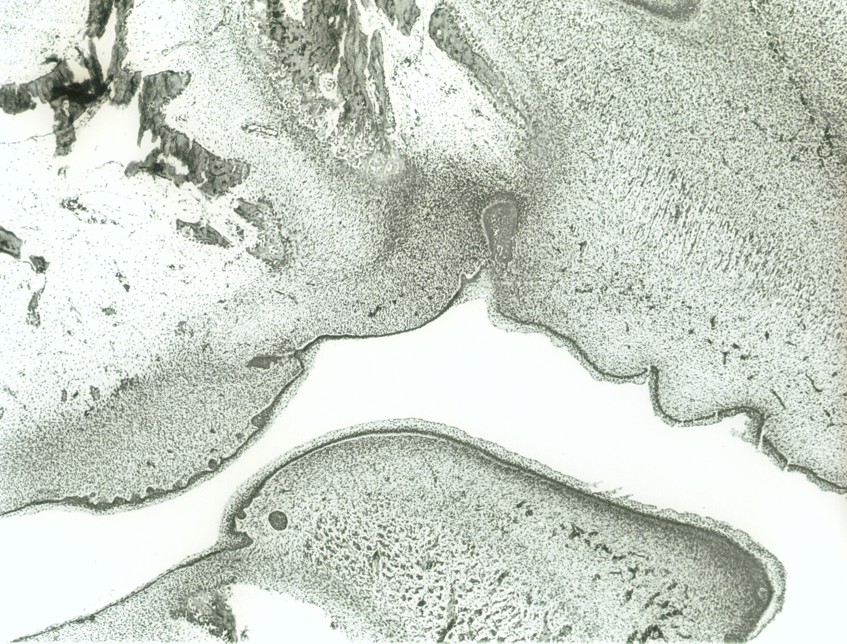
Developing alveolar bone
(Maxilla)
Dental lamina
Primary stomodeum
Tongue

Slide 4
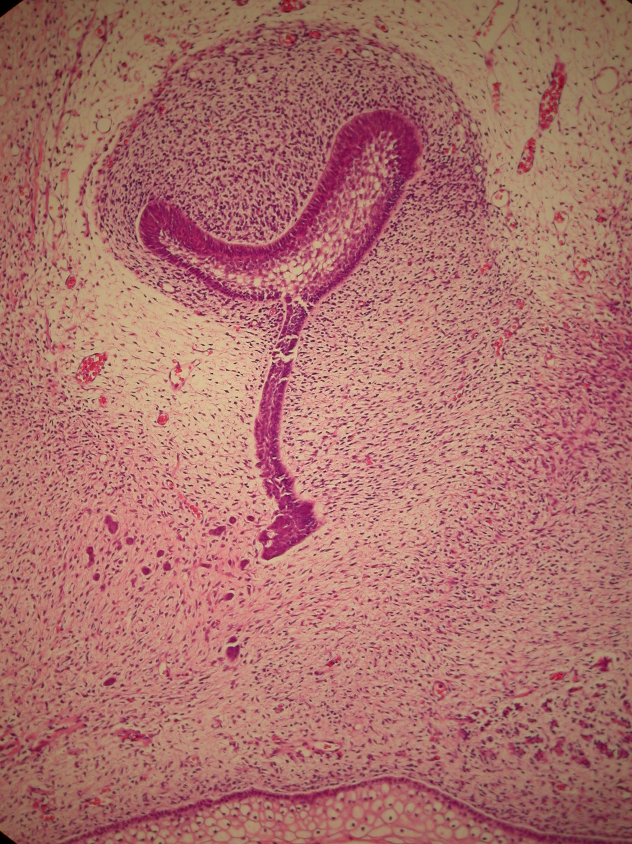
Tooth follicle (ectomesenchyme)
Cap stage of enamel organ
(ectoderm)
Dental lamina
Rests of Seres
Mucosa

Slide 5
Ectoderm
(Ameloblasts deposit enamel)
Mesenchyme
(Odontoblasts deposit dentine, Cementoblasts deposit cementum, Fibroblasts deposit periodontal and pulpal tissue)

Slide 6
Classification of odontogenic tumors
Benign
Malignant

Slide 7
Classification of Odontogenic Tumours
BENIGN
Odontogenic epithelium: ameloblastoma, adenomatoid odontogenic tumor, calcifying epithelial odontogenic tumor, squamous odontogenic tumor, clear cell odontogenic tumor
Odontogenic epithelium & mesenchyme: odontoma, ameloblastic fibroma, ameloblastic fibrodentinoma, ameloblastic fibro-odontoma, odontoameloblastoma
Odontogenic mesenchyme: benign cementoblastoma, odontogenic myxoma, odontogenic fibroma
MALIGNANT
Odontogenic carcinomas (odontogenic epithelium): malignant ameloblastoma, primary intraosseous ca, malignant changes in cysts
Odontogenic carcinosarcoma (mixed epithelial & mesenchymal dental tissue)
Odontogenic sarcomas: (odontogenic mesenchyme) ameloblastic sarcoma (fibro-, dentino- or odontosarcoma)

Slide 8
Group 1:
Benign epithelial odontogenic tumors

Slide 9
Ameloblastoma
Central (in bone)
Unilocular
Multilocular
Peripheral (in soft tissues)

Slide 10
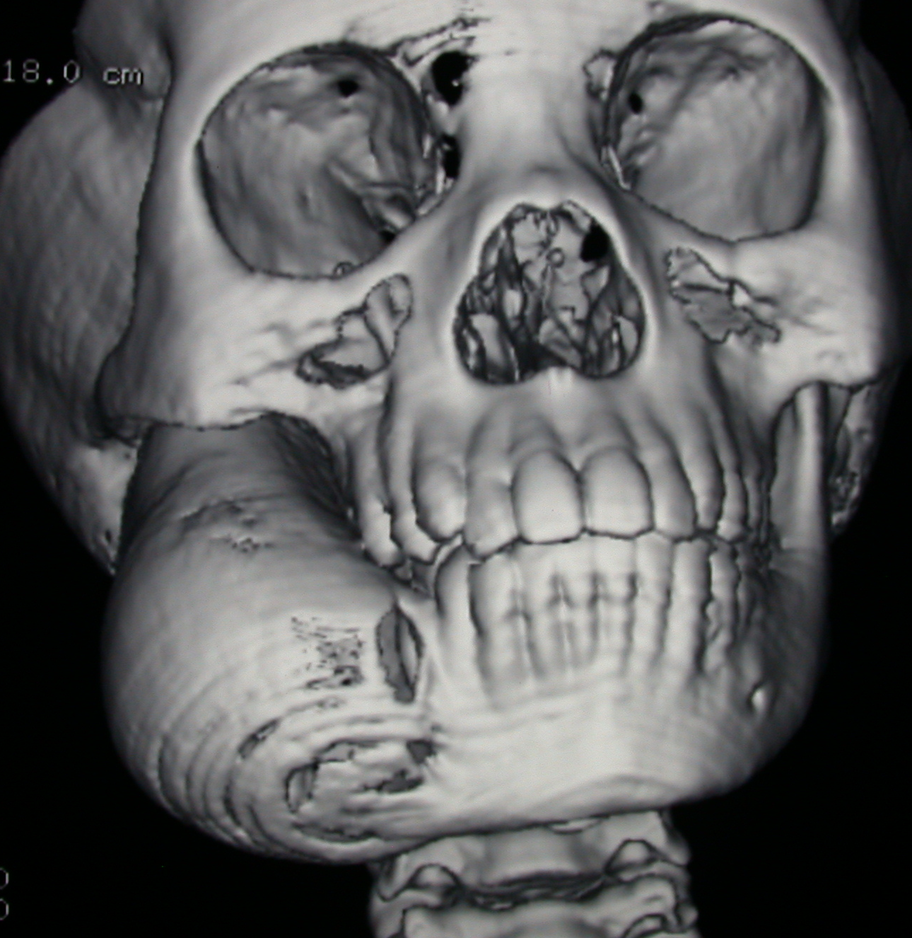
Cortical expansion with perforation in large lesions

Slide 11
Central
Unilocular ameloblastoma
Site: posterior mandible, but more common in the anterior mandible than the multilocular type
Gender and age: more males, most frequently 3rd decade
Clinical: expansion with egg-shell thinning, tooth displacement, nerve intact
Imaging: well demarcated radiolucency with tooth displacement and resorption of adjacent roots. Cortical perforation with large lesions
Microscopy: unilocular cavity lined by ameloblasts, Type I: simple type, Type II: intraluminal proliferation, Type III: mural invasion (see later)
Management: wide resection, high recurrence rate if enucleated

Slide 12
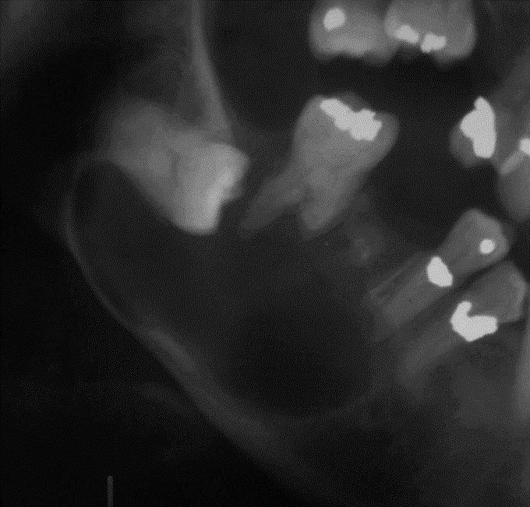
Unilocular ameloblastoma
Root resorption & cortical expansion
May mimic dentigerous cyst

Slide 13
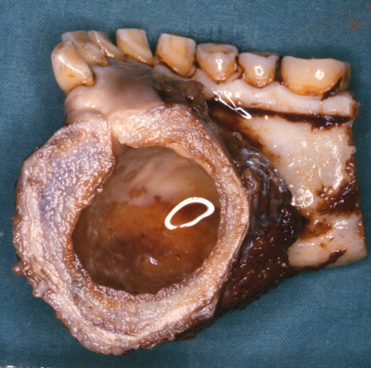
Unilocular ameloblastoma
Straw coloured fluid
Expansion
cavity
Anterior mandible: Cross section through surgical specimen shows labial and lingual expansion with unilocular cavity

Slide 14
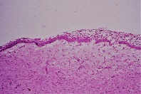
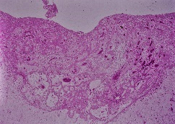
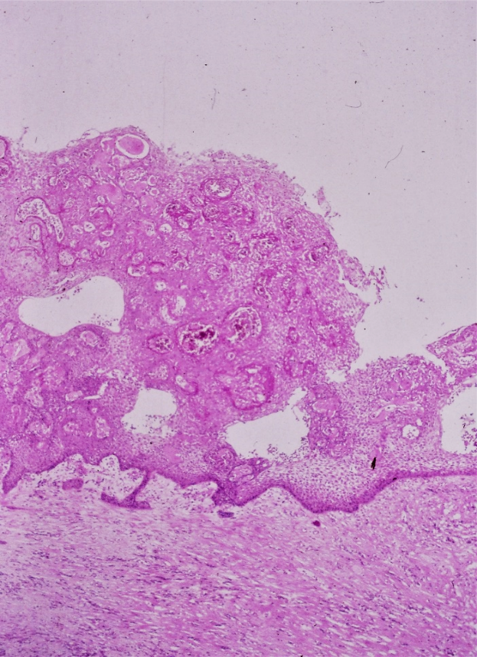
Unilocular ameloblastoma
cavity
Type I
lining
Type III
Type II
Microscopic subtypes

Slide 15
Central
Multilocular ameloblastoma
Site: posterior mandible, rare in maxilla
Gender and age: more in males, most commonly in 4th decade
Clinical: expansion, tooth displacement, inferior alveolar canal may be displaced but nerve remains intact
Radiology: radiolucent, multilocular: soap bubble or honey comb appearance, tooth resorption and displacement, may occur around a crown of impacted tooth, expansion
Microscopy: ameloblastic epithelium growing in follicles and plexiform strands with cystic degeneration
Management: wide resection, recurs if incompletely removed. Multiple recurrence associated with malignant change

Slide 16
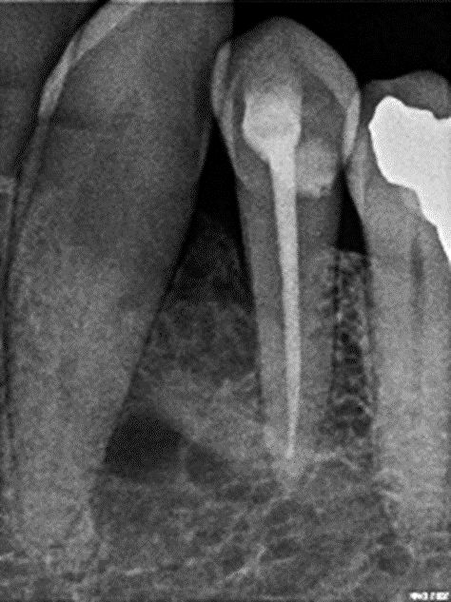
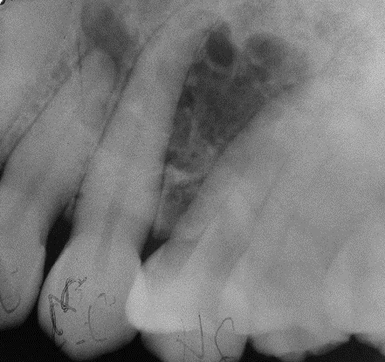
Multilocular ameloblastoma
Rare in maxilla, multilocular, honey comb appearance
root displacement
Mandible, multilocular, soap bubble appearance,

Slide 17
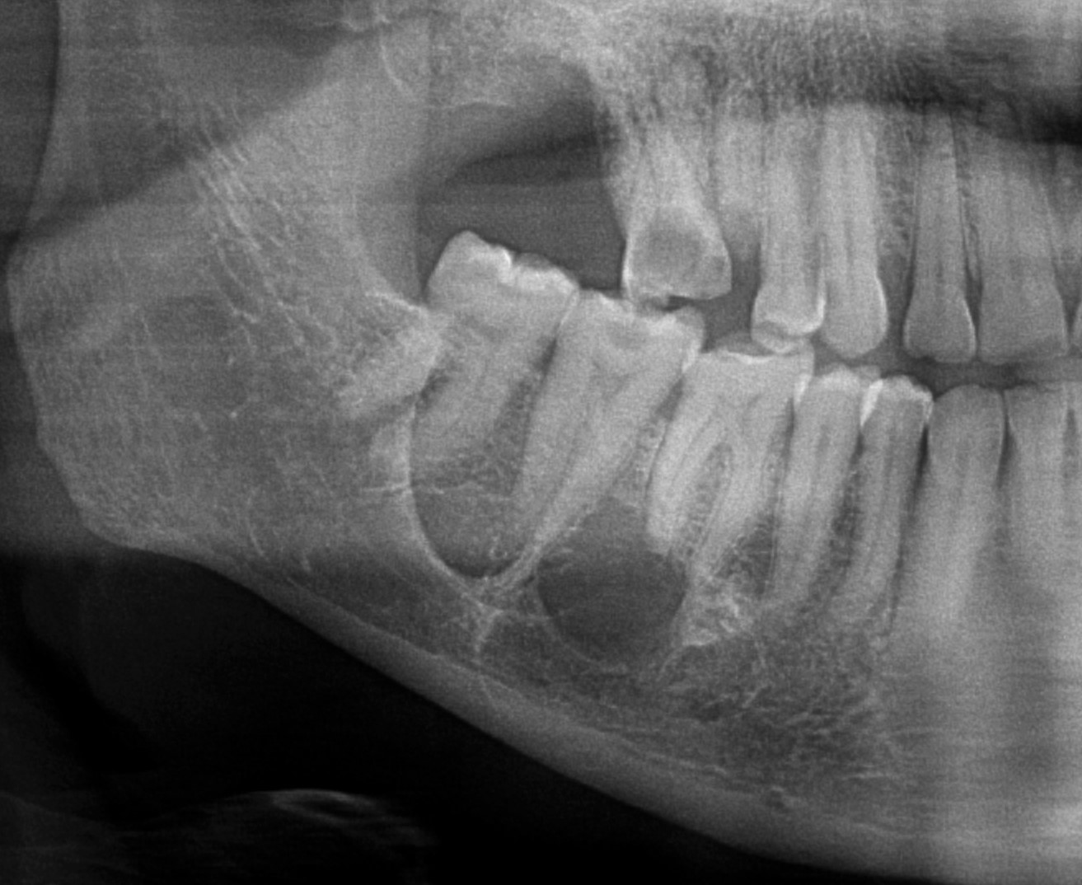
Soap bubble appearance

Slide 18
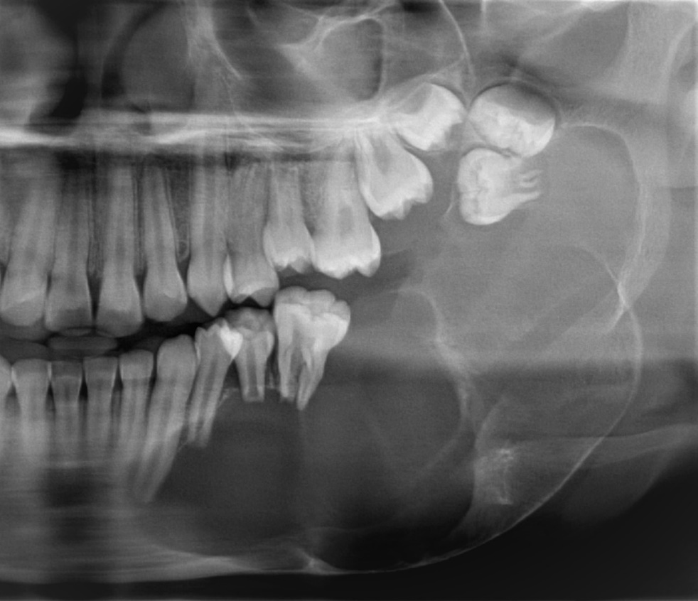
Multilocular ameloblastoma
Absence of anterior border of ramus, expansion and soap bubble appearance, displacement of teeth and root resorption

Slide 19
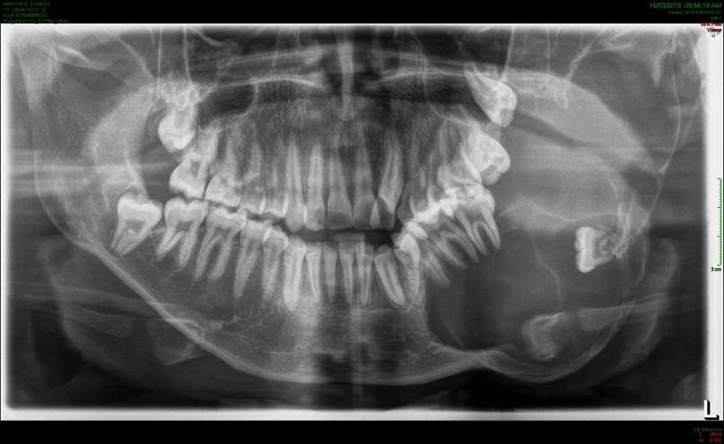
Multilocular ameloblastoma
Multilocular soap bubble appearance, severe expansion

Slide 20
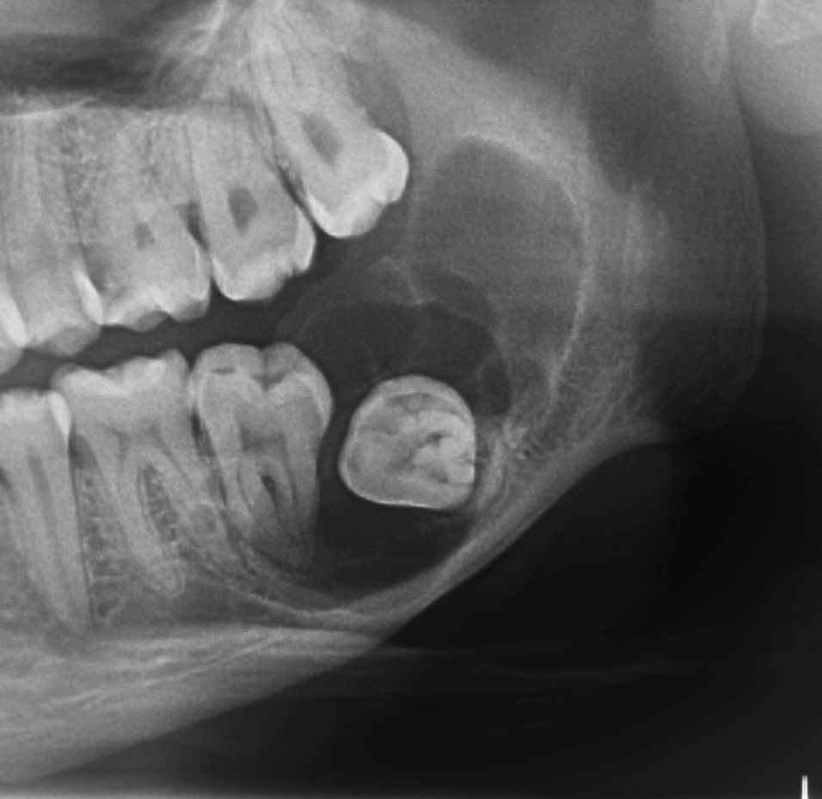
Multilocular ameloblastoma
Well-defined, impacted and displaced 38, soap bubble appearance,

Slide 21
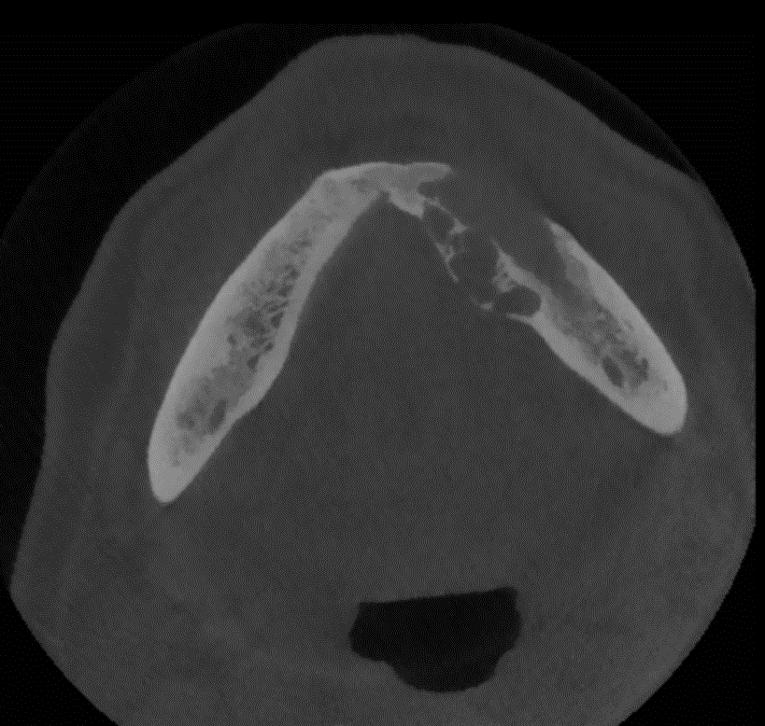
Multilocular ameloblastoma
Expansion and destruction of the buccal cortical plate of the mandible

Slide 22
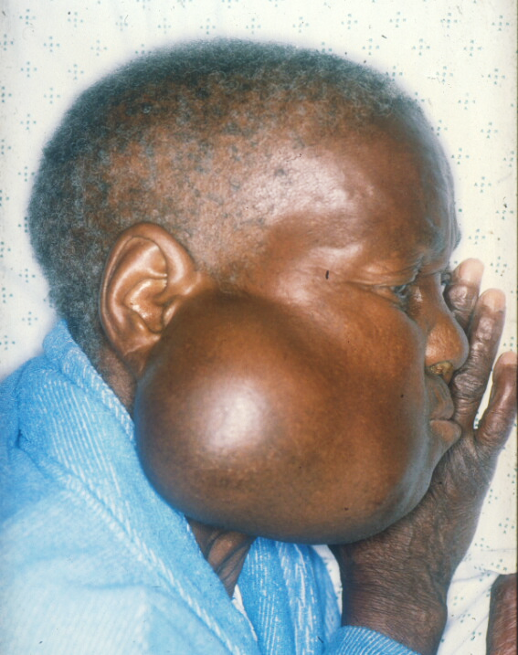
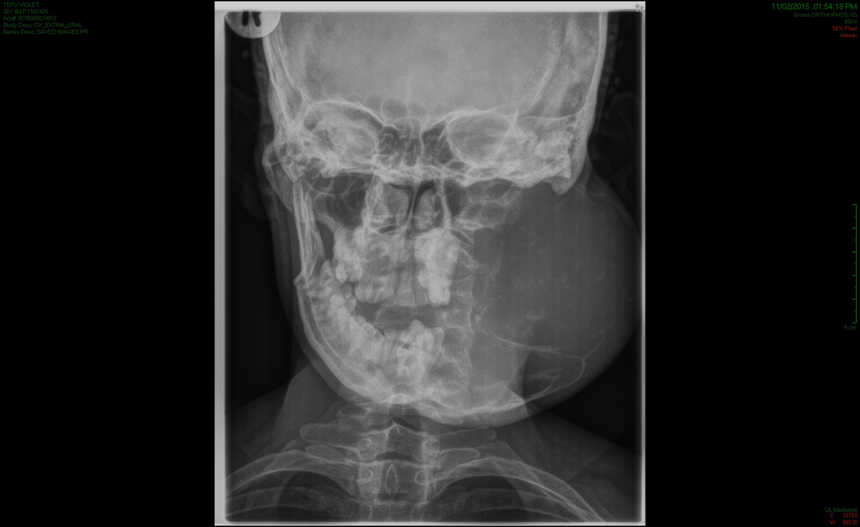
Multilocular ameloblastoma
Large neglected lesion

Slide 23
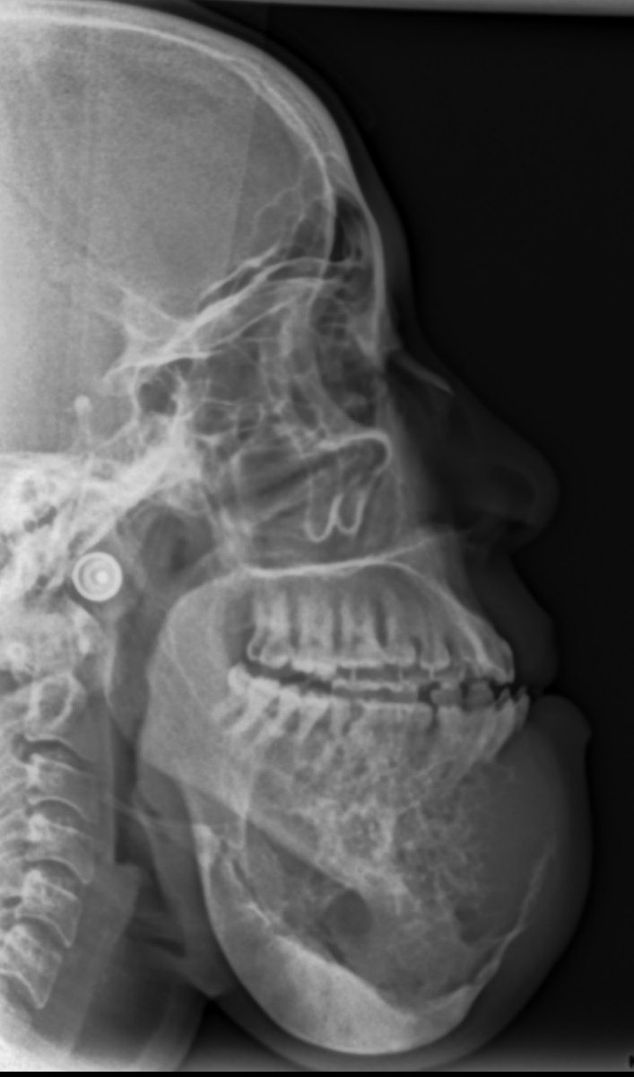
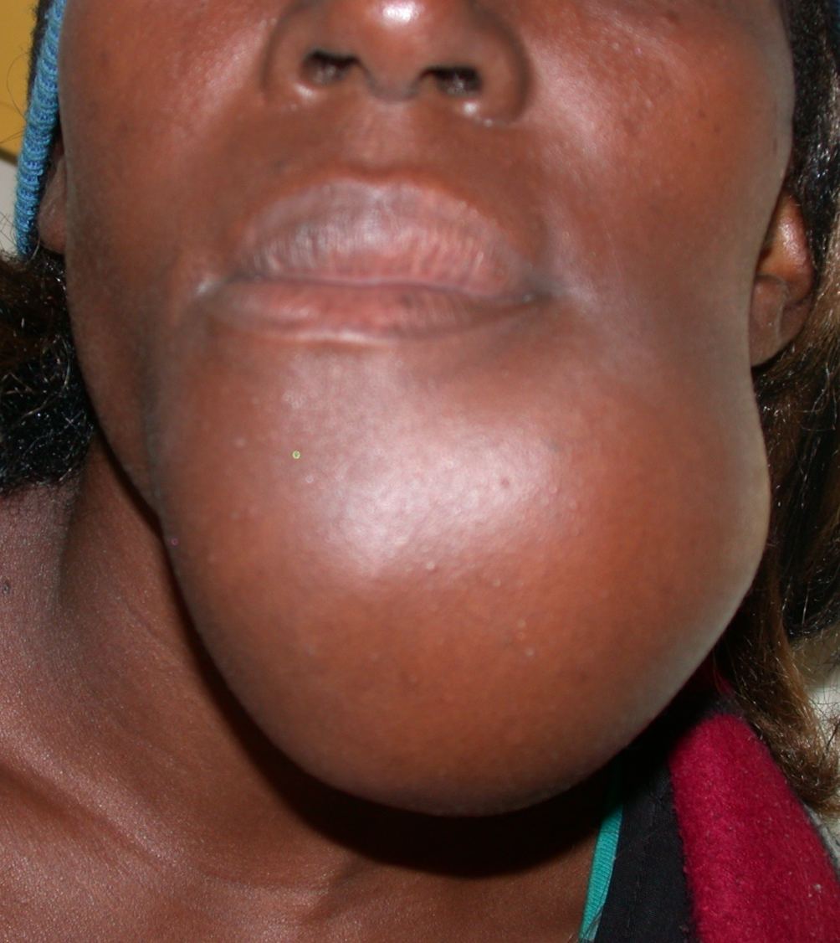
Multilocular ameloblastoma
Neglected case, crossing midline

Slide 24
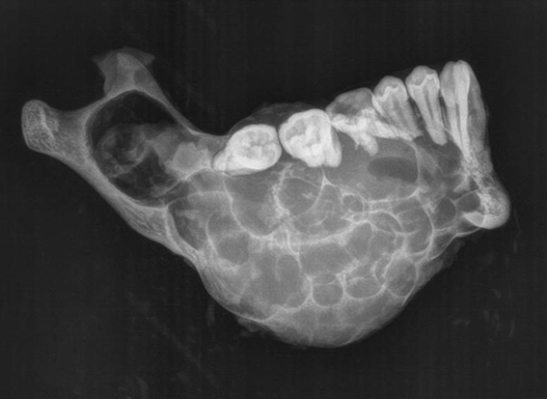
Multilocular ameloblastoma
Resection specimen: expansion into the sigmoid notch and condylar neck, soap bubble appearance

Slide 25
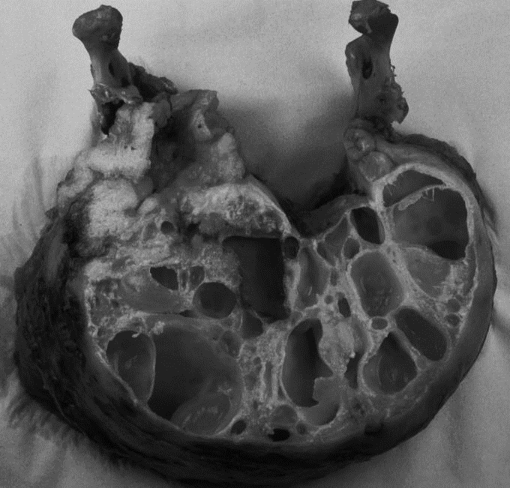
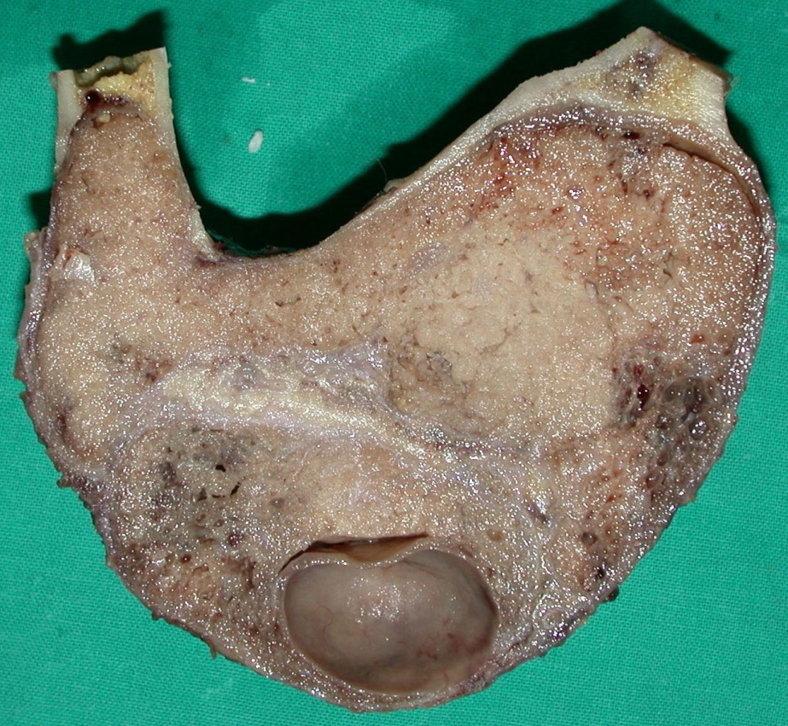
Multilocular ameloblastoma
Macroscopic: Cystic and solid subtypes

Slide 26
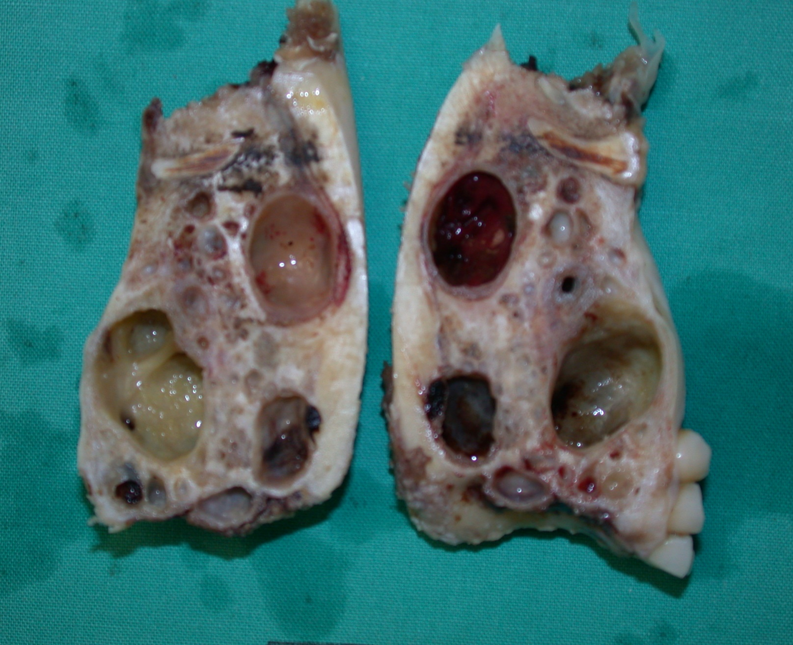
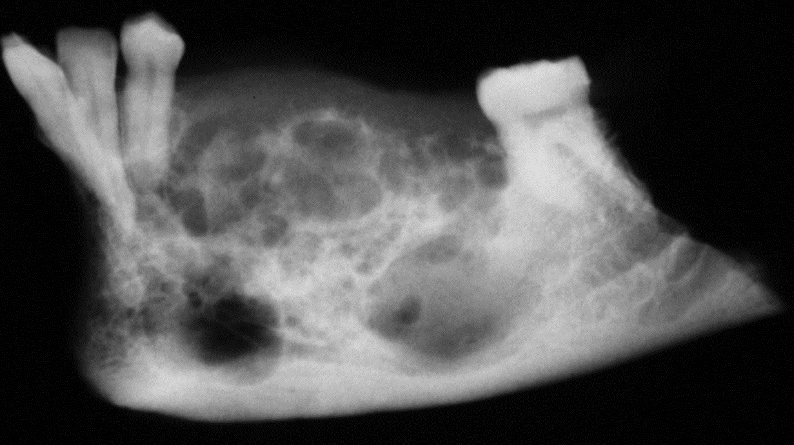
Multilocular ameloblastoma
Excision specimen, macroscopically
Mixed cystic-solid type, same case
Image of above specimen

Slide 27
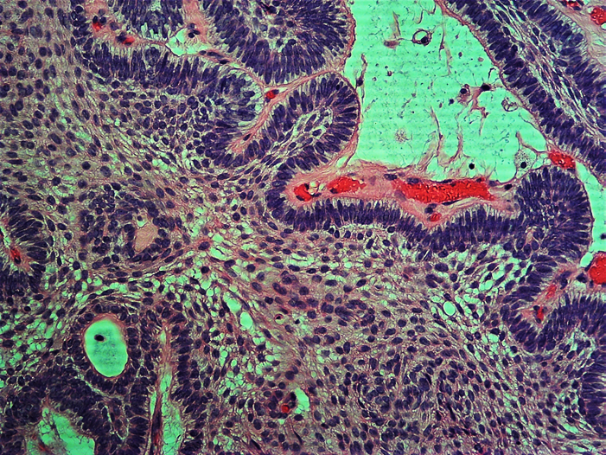
Multilocular ameloblastoma
Early cyst formation

Slide 28
Adenomatoid odontogenic tumor
<5% of odontogenic tumors, classified into the follicular type (73% of cases, associated with the crown of an impacted tooth) and the extrafollicular type (no association with an impacted tooth)
Age & gender: second decade, average 16 years; female predilection (2 : 1)
Clinical: often associated with a missing tooth; painless swelling
Site: anterior to first molar, 75% in maxilla, 25% in mandible
Imaging: frequently attached to an impacted canine, but usually not at the cemento-enamel junction. Well-defined corticated border, radiolucent (1/3 of cases) or varying amounts of internal calcifications
Microscopic: odontogenic epithelium arranged in gland-like nests and rosettes with focal calcifications
Different diagnosis: calcifying odontogenic cyst, dentigerous cyst, calcifying epithelial odontogenic tumor
Management: enucleation, does not recur

Slide 29
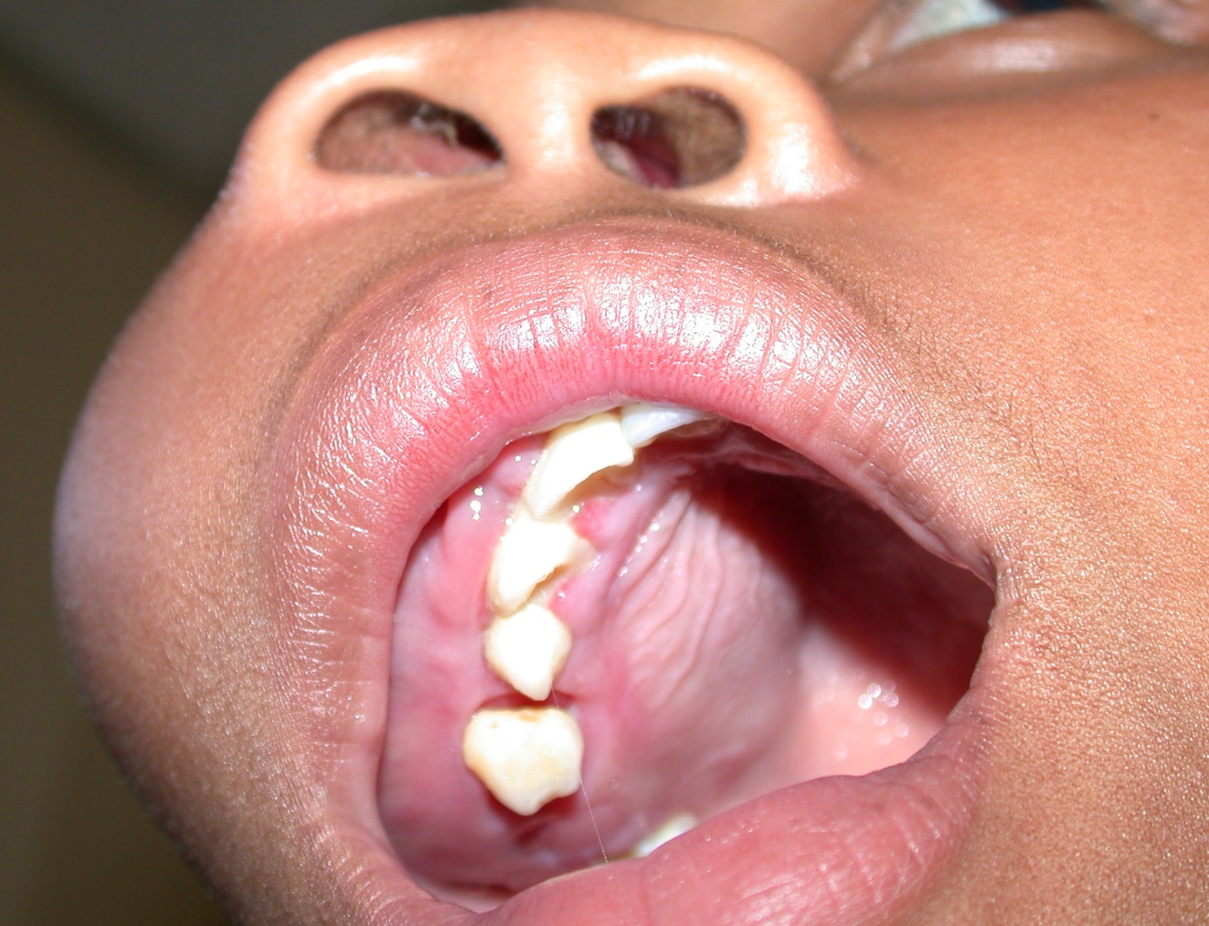
Adenomatoid odontogenic tumor
Large example

Slide 30
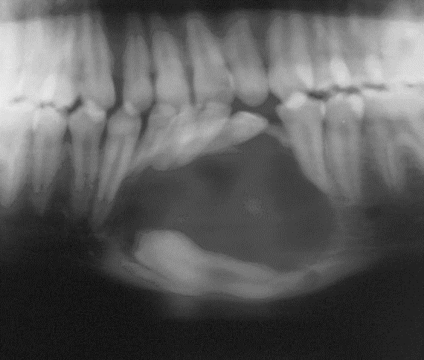
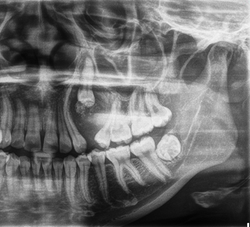
Adenomatoid odontogenic tumor
(follicular type)
Without calcifications
With calcifications

Slide 31
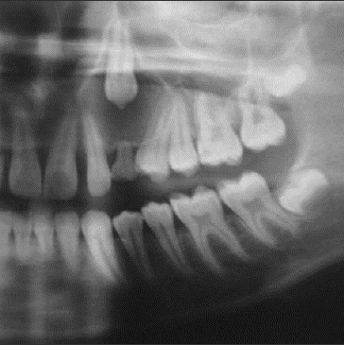
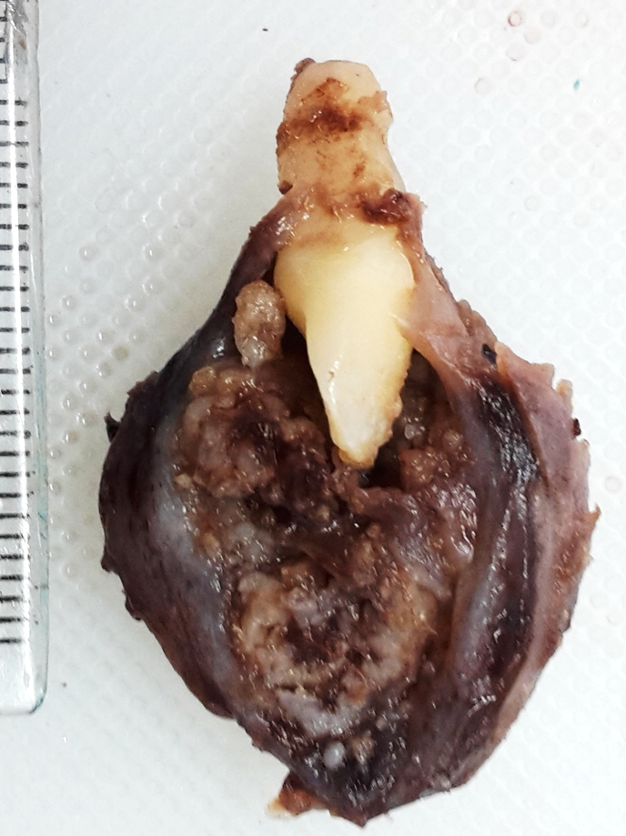
Adenomatoid odontogenic tumor
(follicular type)
Image and surgical specimen of the same case: note the attachment of the tumor apical to the CEJ and the “sago-granules” in the surgical specimen.

Slide 32
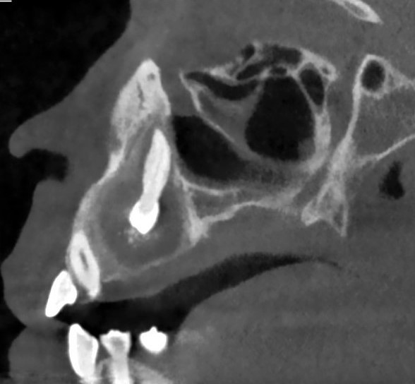
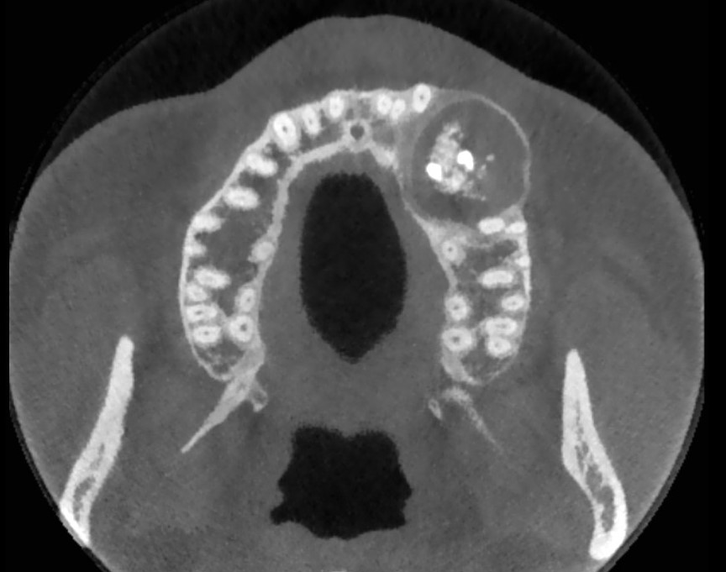
Adenomatoid odontogenic tumor (follicular type)
With calcifications

Slide 33
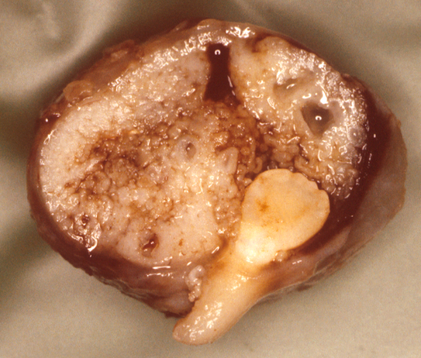
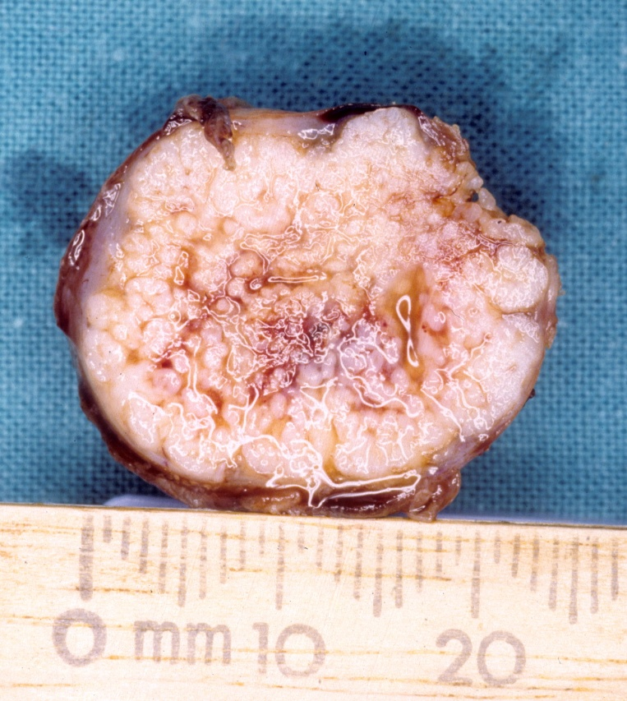
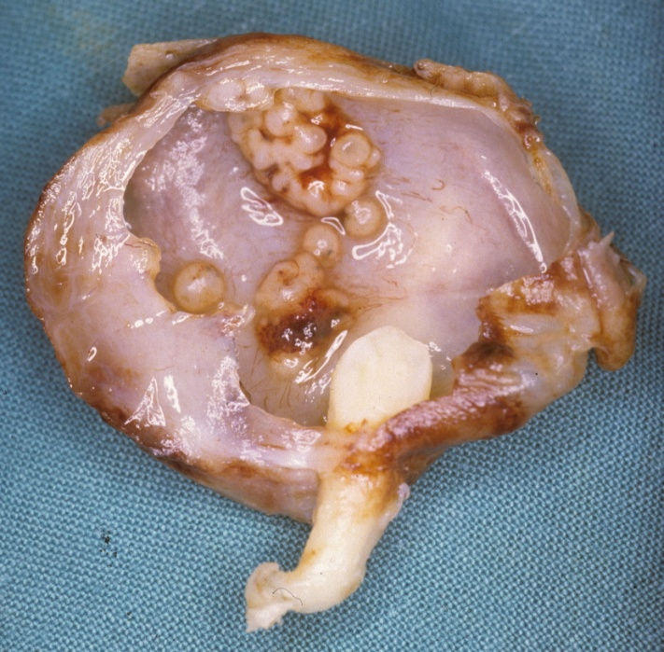
Sago
granules
Solid and cystic types

Slide 34
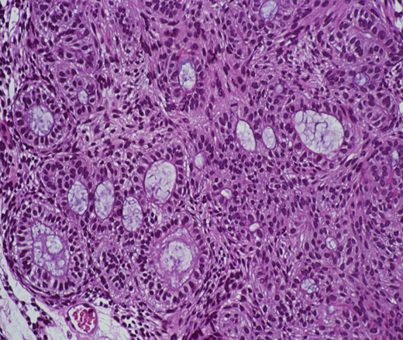
Adenomatoid odontogenic tumor

Slide 35
Calcifying epithelial odontogenic tumor
Rare, central in bone with a rare peripheral (soft tissue) variant
Age: 20-60 years (average 40 years)
Gender: males to females 2:1
Site: premolar/molar area of posterior jaw bones
Clinical: expansion, commonly associated with an unerupted tooth; displaced teeth and root resorption
Imaging features: well to ill-defined, unilocular or multilocular, multiple small radiopacities described as the “driven snow” appearance
Microscopic: epithelium with calcifications
Differential: lesions with radiopacities e.g. adenomatoid odontogenic tumor, ameloblastic fibro-odontoma, calcifying odontogenic cyst. When no calcifications are present, difficult to distinguish from an ameloblastoma

Slide 36
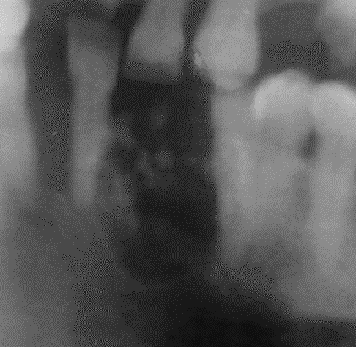
Calcifying epithelial odontogenic tumor
Small lesion with a driven snow appearance

Slide 37
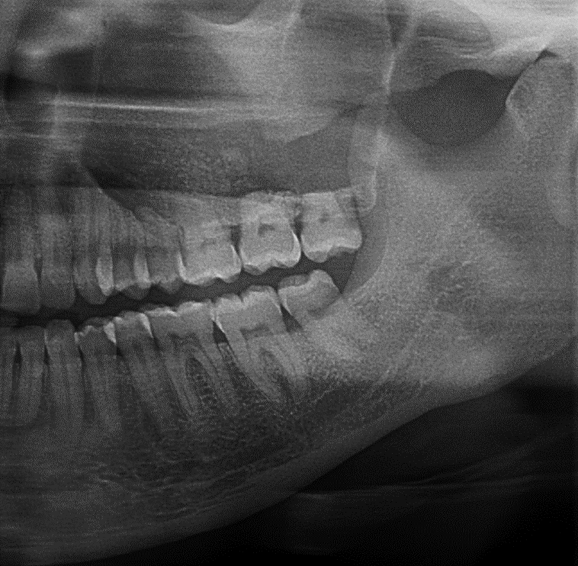
Calcifying epithelial odontogenic tumour
Left maxilla: driven-snow appearance with external root resorption

Slide 38
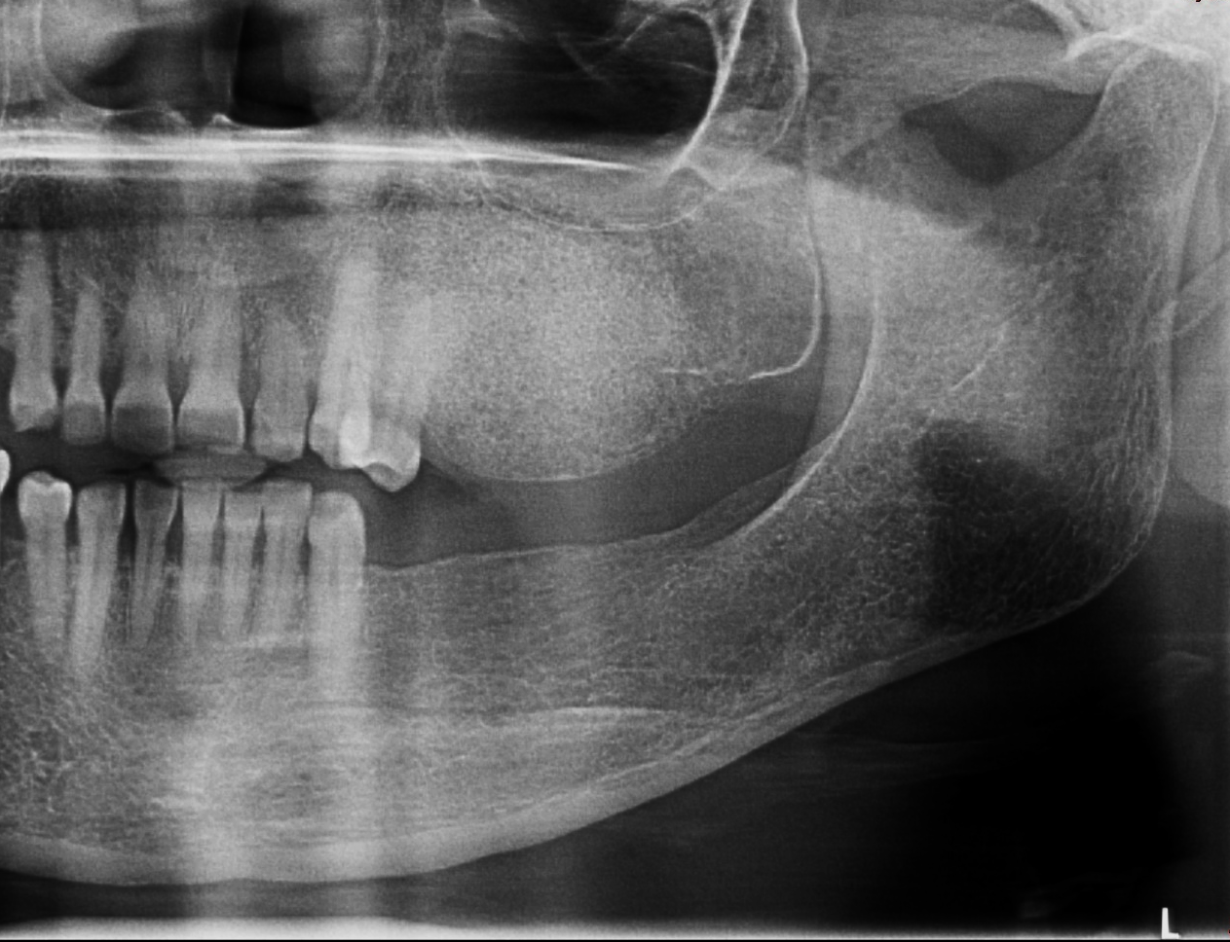
Calcifying epithelial
odontogenic tumor
Driven snow appearance in a maxillary edentulous alveolar process

Slide 39
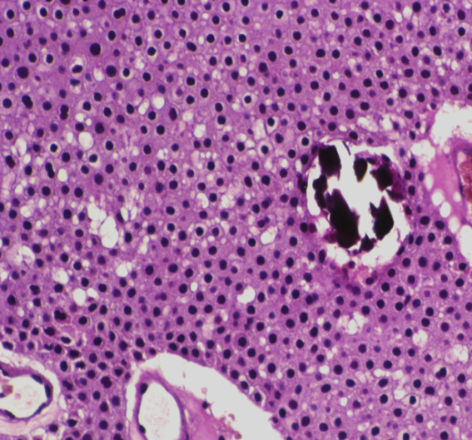
Calcifying epithelial odontogenic tumor
Epithelium
Calcification

Slide 40
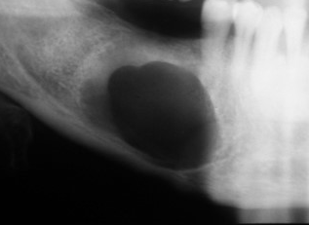
Squamous odontogenic tumor
&
Clear cell odontogenic tumor
Rare, mandible
Diagnosis is microscopic: squamous epithelium or clear cells

Slide 41
Group 2:
Mixed epithelial – mesenchymal odontogenic tumors

Slide 42
Odontoma
Common, hamartomatous nature, forms during development of permanent dentition and cease to grow when teeth are fully developed
Clinical: interfere with the eruption of the adjacent tooth/teeth, cause impaction, diastema or malpositioning of teeth. They may erupt
Age: 2nd decade
Types: complex type: molar region, compound type: canine region Exceptions are possible
Imaging:
Compound type: well-defined, small tooth-like structures surrounded by a thin radiolucent capsule which is often surrounded by a well-defined corticated border. Usually no expansion
Complex type: well-defined with irregular densely calcified internal structure that bears no resemblance to a tooth, surrounded by a radiolucent capsule; expansion possible
Dilated odontoma: a single radiopaque structure with a radiolucent center which resembles a doughnut
Microscopic: all tissue types of a tooth
Differential: ossifying fibroma, solitary cemento-osseous dysplasia

Slide 43
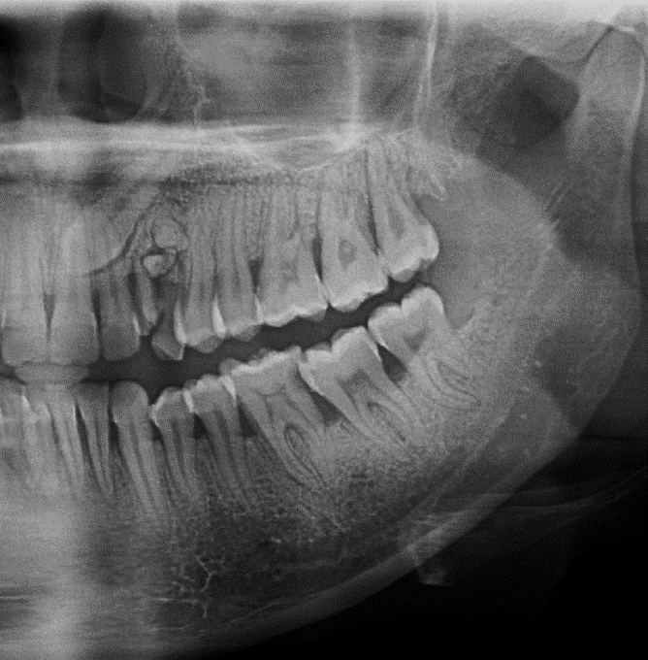
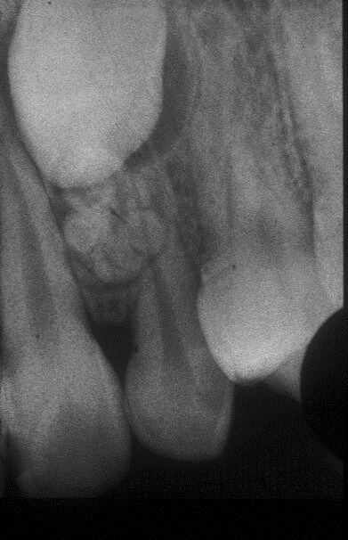
Odontoma (compound)
Impaction of a permanent tooth in the anterior maxilla

Slide 44
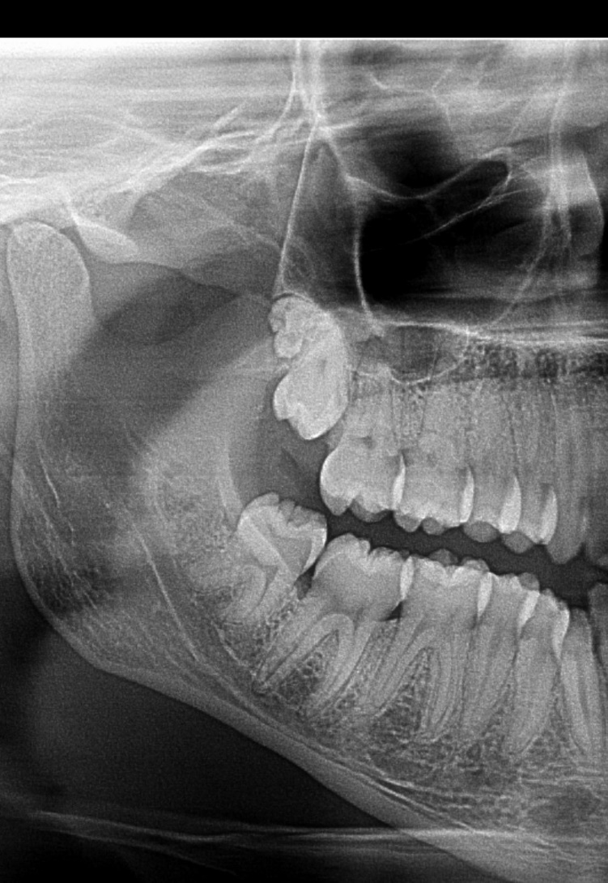
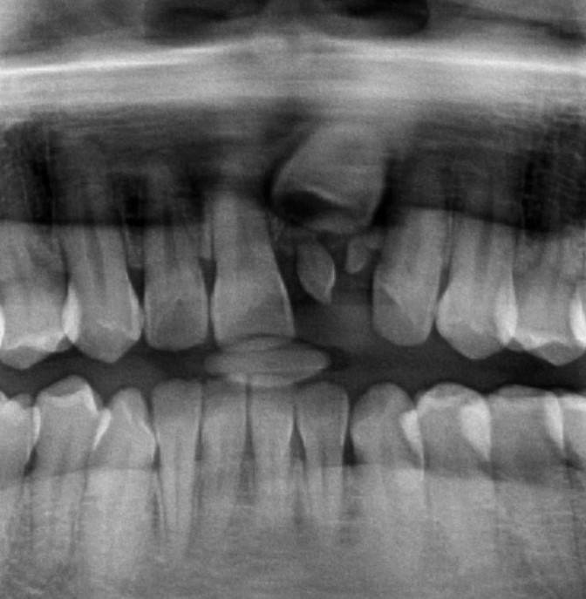
Odontoma (compound)
Compound odontoma, rare in posterior region
Impaction of permanent incisor

Slide 45
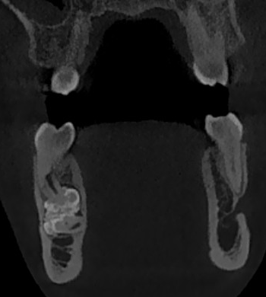
Odontoma (compound)
CBCT of a mandibular compound odontoma that consists of organized tooth like-structures with enamel clearly visible

Slide 46
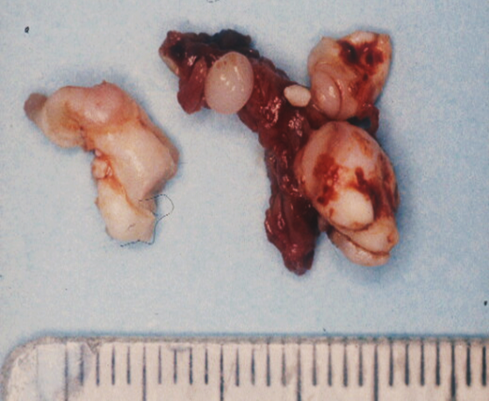
Odontoma (compound)
Surgical specimen: multiple tooth-like structures characteristic of a compound odontoma

Slide 47
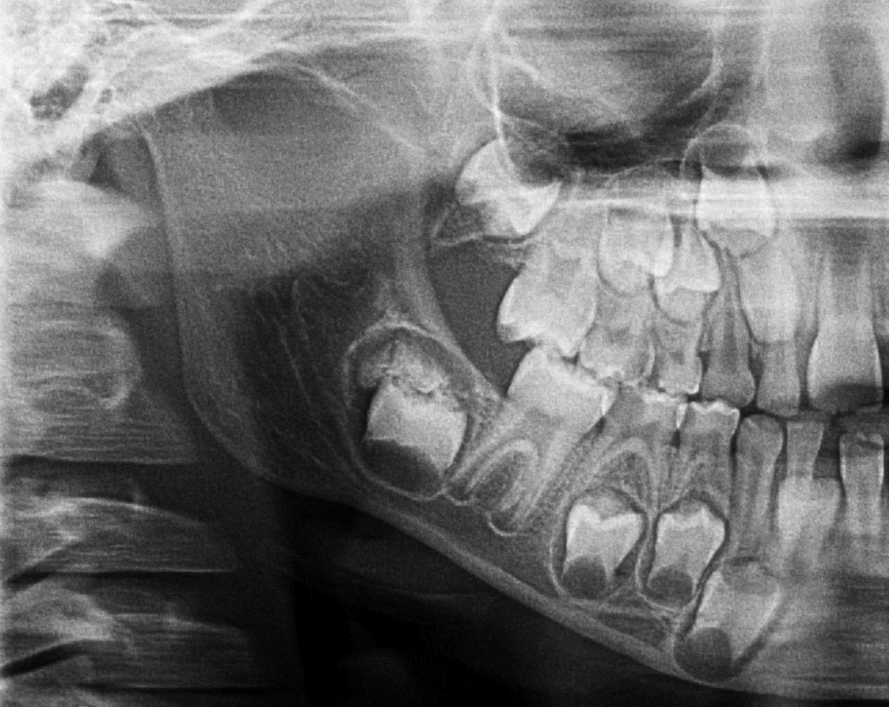
Odontoma (complex)
Impaction of a molar by a complex odontoma. Note the irregular calcified mass surrounded by a radiolucent rim

Slide 48
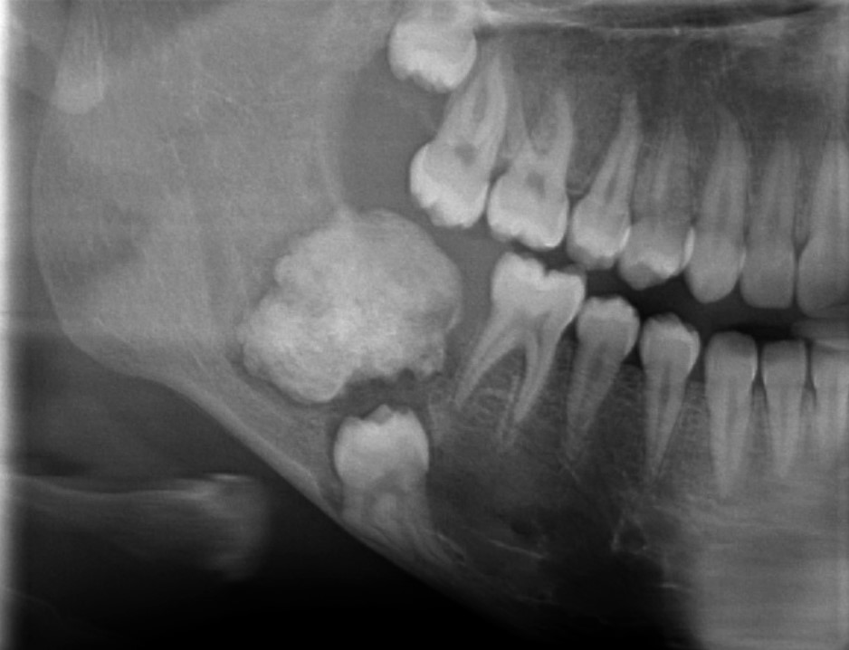
Odontoma (complex)
A large complex odontoma in the eruption path of a mandibular third molar

Slide 49
Ameloblastic fibroma
Uncommon, similar to ameloblastoma but occurs in younger age
Age: first and second decade (average at 14-15 years)
Site: premolar-molar area of mandible, less common in maxilla
Clinical features: painless expansion, small lesions are most frequently close to alveolar crest, associated with an impacted or missing tooth (50%), displacement of adjacent teeth
Imaging features: resembles ameloblastoma; well defined, corticated, radiolucent, unilocular or multilocular with internal curved septa; large lesions expand and displace teeth
Microscopic: similar to ameloblastoma with odontogenic mesenchyme
Differential: small: dentigerous cyst and hyperplastic follicle, large: giant cell granuloma, ameloblastoma

Slide 50
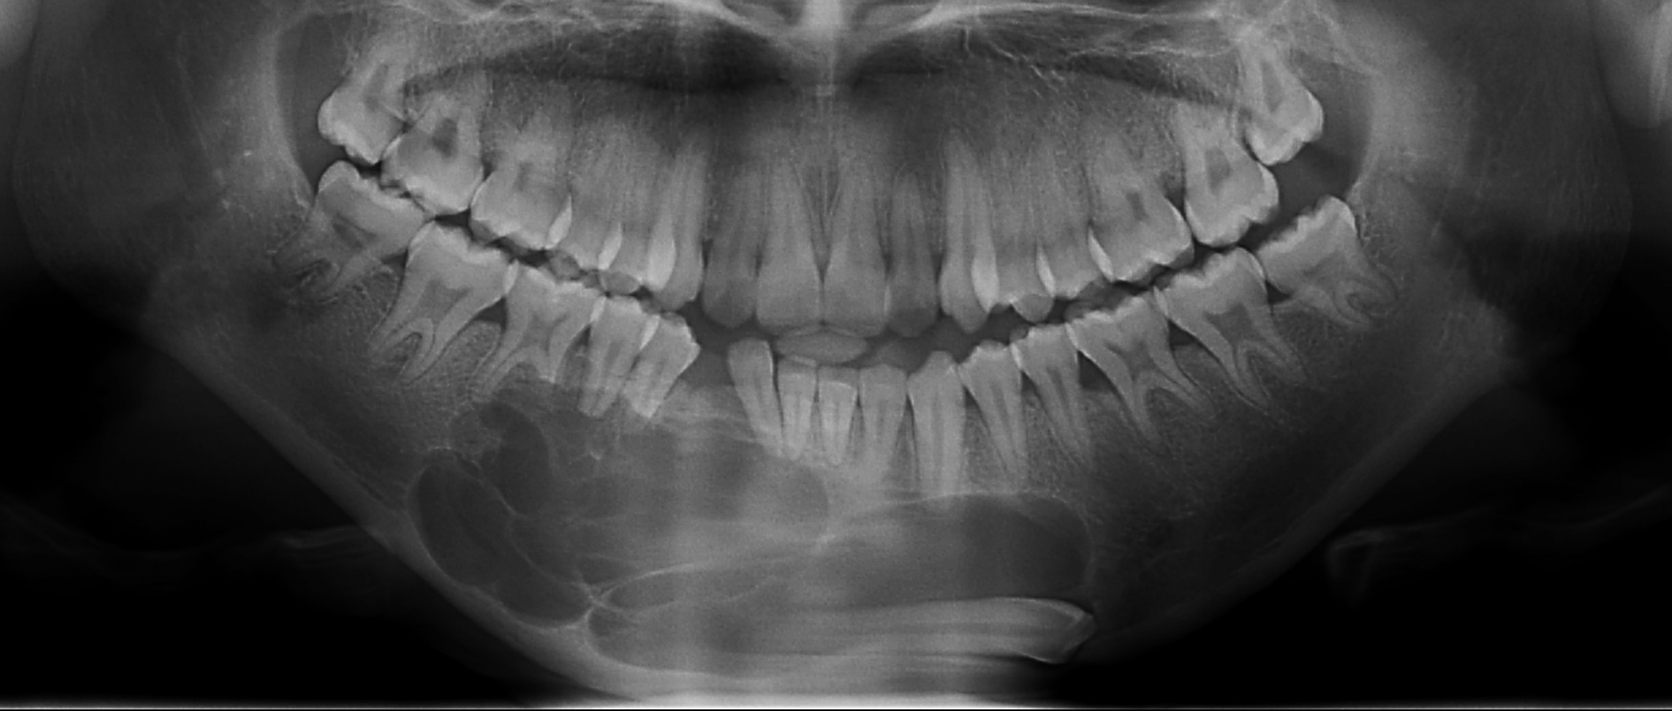
Ameloblastic fibroma
Multilocular, impacted and displaced canine

Slide 51

Ameloblastic fibroma
6 yr child, expansion and displacement of incisor teeth, unilocular

Slide 52

Ameloblastic fibroma

Slide 53
Ameloblastic fibro-dentinoma
&
Ameloblastic fibro-odontoma
Uncommon
Age: same as ameloblastic fibroma. The diagnosis depends on the microscopic tissue types
Clinical features: same as ameloblastic fibroma
Imaging features: mixed, radiolucent with few or numerous calcifications (small and round), or multiple scattered mature small pieces of enamel or dentine-like tissue
Microscopic: odontogenic mesenchyme with ameloblastic follicles and deposits of either dentine (-dentinoma) or dentine and enamel (-odontoma)
Differential diagnosis: complex odontoma (mainly located in posterior jaw)

Slide 54


Ameloblastic fibro-dentinoma &
Ameloblastic fibro-odontoma
Note the mineralized tissue and impacted and displaced teeth

Slide 55

Ameloblastic fibrodentinoma &
Ameloblastic fibro-odontoma
Mineralized tissue indicated by arrows

Slide 56

Ameloblastic fibro-dentinoma &
Ameloblastic fibro-odontoma
Ameloblastic fibroma with hard tissue formation

Slide 57

Odontoameloblastoma
Rare: less than 50 cases reported
Males, body of mandible
Imaging: resembles an ameloblastoma with calcifications
Diagnosis is microscopic

Slide 58
Group 3:
Mesenchymal odontogenic tumors

Slide 59
Odontogenic myxoma
Uncommon, occurs only in jaw bones, slow-growing painless lesion
Age: 2nd – 4th decade
Clinical: size varies, may cause large swelling, may invade maxillary antrum, tooth displacement
Site: mandible:maxilla 3:1, premolar/molar area; rarely in ramus and condyle
Imaging: poorly defined in maxilla, variable cortication, smooth or scalloping border, rarely a spiculated peripheral cortical appearance that resembles osteosarcoma, unilocular but occasionally multilocular. The internal structure shows septa which may be straight, sharp and fine resembling a tennis-racket or curved (honey comb- and rarely a soap bubble appearance). Straight septa are characteristic for this tumor. Occasional tooth resorption.
Microscopic: loosely woven gelatinous mesenchyme
Differential: multilocular ameloblastoma, central giant cell granuloma, central hemangioma

Slide 60


Odontogenic myxoma
Expansion of mandibular and maxillary alveolar processes. Note the dental indentations

Slide 61

Odontogenic myxoma
Internal structure shows tennis racket appearance

Slide 62

Odontogenic myxoma
Tennis racket / lace like pattern

Slide 63

Odontogenic myxoma
Large myxoma with tooth displacement and internal septa arranged at right angles (tennis racket appearance)

Slide 64

Odontogenic myxoma
Expansion into the ramus, well defined multilocular, cortical thinning.

Slide 65

Odontogenic myxoma
Myxoid appearance

Slide 66
Cementoblastoma
Rare; usually associated with permanent teeth (rare in primary dentition)
Age: 2nd to 4th decade
Clinical: may be painful, associated with a vital permanent tooth, displacement of adjacent tooth/teeth, cortical bony expansion and perforation when large
Site: posterior mandible, rare in maxilla
Imaging: up to 2-3 cm in diameter, well-defined mixed or radiopaque lesion attached to the apex of a molar or premolar surrounded by a radiolucent rim and frequently a corticated border, external root resorption is characteristic
Microscopic: cementum deposited on root surface
Differential diagnosis: focal cemento-osseous dysplasia, hypercementosis, focal sclerosing osteomyelitis; dense bone island

Slide 67

Cementoblastoma
Well defined with radiolucent rim and cortical border

Slide 68

Cementoblastoma
Attached to root, root resorption, radiolucent capsule

Slide 69
Odontogenic fibroma
Rare, both central (in bone) and peripheral (in soft tissue) types
Age: 11 to 39 years, female:male 2.2:1
Clinical: asymptomatic, swelling, mobility of teeth
Site: more common in mandible, molar/ premolar region
Imaging: well defined, unilocular (radiolucent and cyst-like) or multilocular, expansion common in mandible but rarely in maxilla, tooth displacement and root resorption
Microscopy: odontogenic mesenchyme with inactive epithelial remnants
Differential: odontogenic myxoma, giant cell granuloma

Slide 70

Odontogenic fibroma (central type)
Multilocular odontogenic fibroma

Slide 71
Malignancies of odontogenic origin
(WHO 2017)
Odontogenic carcinoma
Ameloblastic carcinoma
Primary intraosseous carcinoma
Sclerosing odontogenic carcinoma
Clear cell odontogenic carcinoma
Ghost cell odontogenic carcinoma
Odontogenic carcinosarcoma
Odontogenic sarcoma

Slide 72
Malignant odontogenic tumors
Frequently develop in neglected and recurrent ameloblastoma.
Clinical: adults, prevalent in posterior mandible, rapidly enlarging central destructive growth, permanent anesthesia with soft tissue ulceration and pathological fracture at a late stage
Imaging: poorly defined destructive growth within bone often with floating teeth, moth eaten appearance, cortical bone destruction and soft tissue infiltration
Microscopy: diagnosis depends on microscopic examination
Differential: mucosal malignancies that infiltrate the jaw bones, metastatic lesions, osteosarcoma and suppurative osteomyelitis

Slide 73

Malignant odontogenic tumors
Extensive cortical bone destruction

Slide 74

Malignant odontogenic tumors
Poorly circumscribed and destructive

Slide 75


Odontogenic malignancies
Malignant odontogenic epithelium resembling the follicles of an ameloblastoma with mitotic activity and necrosis

Slide 76

Odontogenic malignancy
Ameloblastic carcinoma: note the destruction of the inferior cortex with soft tissue invasion and breaching of the alveolar crest without the expansion that is characteristic of an ameloblastoma.

Slide 77

Odontogenic malignancy
Axial image showing cortical destruction without gross expansion of the mandible

Slide 78

Odontogenic malignancy
Primary intraosseous carcinoma: moth eaten appearance with gross destruction of the left mandible, infiltration of the soft tissue adjacent to the inferior border of the mandible

Slide 79
More information is available on internet and in the prescribed textbook
Thank you for your attention

